Slide 1
How to start a law blog or podcast

Slide 2
Agenda
Why do attorneys blog?
How do you start a blog?
What should you write about?
How to be a great blawger
How to promote your blog
Bar advertising rules
How to measure success
To blog or to podcast?

Slide 3
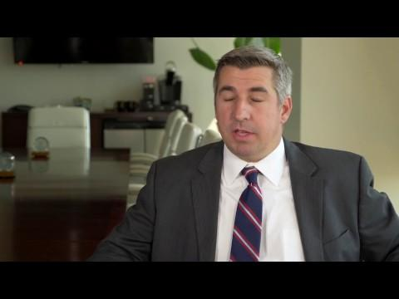
Notes:
About the Jimerson & Cobb blog: https://rep-ink.wistia.com/medias/eqpc8lmq8j

Slide 4
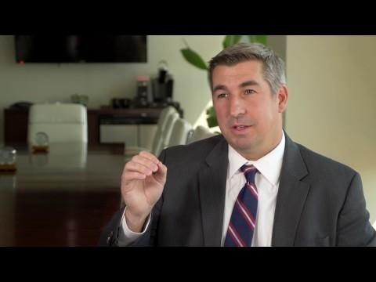
Notes:
Results: https://rep-ink.wistia.com/medias/sd71spomxq

Slide 5
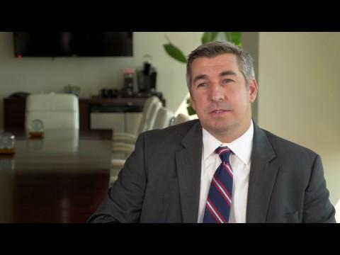
Notes:
Charlie Jimerson's blogging advice: https://rep-ink.wistia.com/medias/gcadr89r7s

Slide 6
Why do attorneys blog?
To get found — search engines love content
To communicate your expertise in a non-salesy way
To broaden your net
Florida divorce attorney, vs.
Is Florida a No-Fault Divorce State?" "Florida Child Support Calculator." "Is Alimony Tax Deductible?" "Florida Law on Child Custody."
To build your reputation
To give clients added value
To build “confident optimism”

Slide 7
How do you start a blog?
Don’t build a house on rented land
Standalone or part of your website?
Domain name:
Should accurately describe your subject matter
Be short and clear
See if it’s free:
Domize.com
Instantdomainsearch.com
Register on GoDaddy
.Law gTLD — http://home.law/

Slide 8
How do you start a blog?
WordPress
Content management system
Custom design v. templates
Set up Google Analytics and Google Search Console
Hosting
BlueHost or WPEngine
Design
Develop a graphic, or logo, for the blog
Notes:
The Genesis Framework
The Thesis Theme
Themes by StudioPress
Themes by SEOThemes

Slide 9
How do you start a blog?

Slide 10
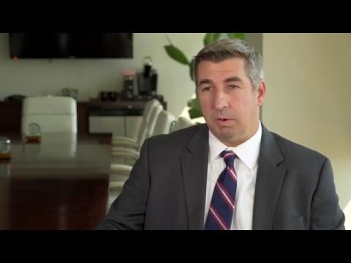

Slide 11
What should you write about?
The more niche, the better
Geographic region
Practice area
Niche subject
Common questions from clients
Clients’ problems/pain points
Analysis of recent court decision, new regulation/law
Trends in the law or within your industry/practice area
Headline news that relates to your practice area
Record court victory or transaction

Slide 12
What should you write about?
Process pages (for example, steps in the criminal process)
Statutory analysis (explain what the statute means in lay terms for readers)
Conference or CLE session summaries
How-to articles (For example, how to choose a family law attorney)
Laws (outline the elements of a cause of action, explain the law in layman’s terms)

Slide 13
What should you write about?
Tips (for example, a DUI firm might offer safe driving tips)
Expose (for example, safety recalls)
Industry predictions
Links to resources around the web
Glossary definitions (define a legal term for readers)
Use Google auto suggest and related searches

Slide 14
How to be a great blawger
Write to one person — your ideal client
No legalese!
Simplify — don’t make it hard for the reader
Add images
Make it scannable
Short paragraphs (VERY short)
Sub-heads
Lists
Bold, italic
Be consistent
Work on your headlines

Slide 15
How to be a great blawger
Create categories
Provide value, analysis, takeaways — don’t just rehash
Be approachable and personal (be yourself!)
Focus on quality and usefulness
Stay in your lane
Invite discussion/ideas
Read other blawgs: http://www.abajournal.com/magazine/article/best_law_blogs_web_100

Slide 16
How to promote your blog
Social media
“Write an article” on LinkedIn
Email marketing
Post to LinkedIn groups
Pitch to trade publications
Email signature
Guest blogging
Talk about/link to others

Slide 17
Bar advertising rules
Don’t be misleading:
Material statements that are factually or legally inaccurate
Omissions of information necessary to prevent misleading consumers
Confidentiality
Client consent is required if information that would identify the client is given – Rule 4-1.6 and comment to 4-7.13

Slide 18
Bar advertising rules
Predictions or guaranties of success or specific results are prohibited; examples:
I can save your home
Stop foreclosure now!
Keep your home
I will get you a settlement
You won’t have to appear in court
I can help you get approved for benefits

Slide 19
Bar advertising rules
What is not a prediction of success — general statements of the law:
The law requires the government to pay just compensation when it takes private property
The law provides that people injured due to the negligence of another are entitled to compensation
Statements qualified by aspirational words such as may, might, could, goal, aim, work
My goal is to get the social security benefits you are entitled to

Slide 20
Bar advertising rules
Comparisons or characterizations of skills:
“Unique” is a big no-no
The “premiere” law firm
Recognized for “excellence”
“Top tier” legal services

Slide 21
Disclaimers
Not legal advice
Website is for informational purposes only and does not provide legal advice
Confidentiality
Readers should not assume it exists
Advertising
Attorney websites, such as this one, are considered attorney advertising
No prior result in a case guarantees a future result that is the same

Slide 22
How to measure success
Traffic
Page views
Traffic sources
Steady growth
Engagement
Time on site and bounce rate
Social media shares
Social media clicks
SEO
First-page rankings for relevant search queries

Slide 23
To blog or to podcast?
Podcast pros:
Build brand, relationships and trust
Connection with the podcaster is deeply personal
Highly engaged audience
Podcast cons:
Not as many people listen to podcasts as read blogs (narrower audience)
Search engines will have an easier time finding text content than audio content
People don’t take action from podcasts
Best law podcasts: http://www.abajournal.com/magazine/article/best_law_podcasts_web_100/P1

Slide 24
rep-ink.com

